Slide 1
S-100 Validation Tests
S-101 PT 11 update
Agenda item 13.2
27th September 2023

Slide 2
AGENDA
Summary of progress
Areas of focus
Parts
S-101PT proposed tests
Delivery to S-100 WG 8 (November 2023)
Inter-product Validation discussion

Slide 3
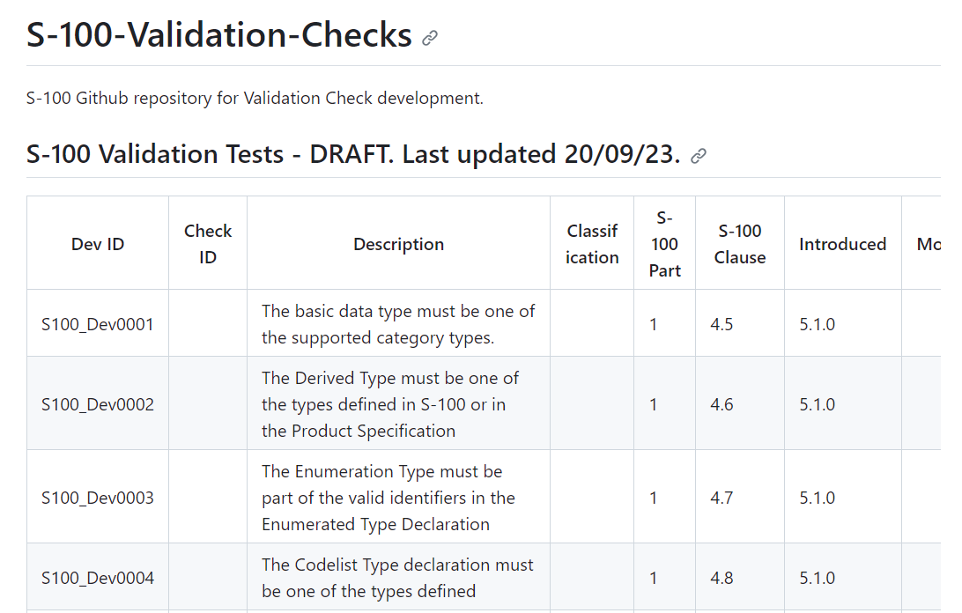
Summary of progress
Focusing on producing content from S-100 parts
Initial tests Part 5, Part 6, Part 7(not finished), Part 8, Part 17 (some from Part1, Part 2, Part 4b)
https://github.com/iho-ohi/S-100-Validation-Checks
154 tests
Need reviewing
Create Issues using Dev ID number
Will continue to add to tests
Also available in spreadsheet format
https://github.com/iho-ohi/S-100-Validation-Checks/tree/main/Documents

Slide 4
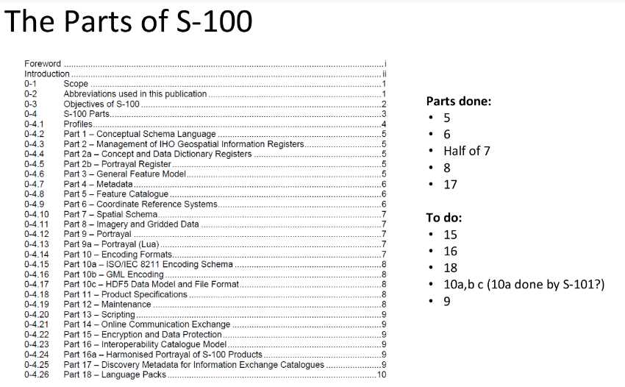
S-100 Parts to focus on

Slide 5
S-101pt generic S-100 tests – (Part 1)
Need to be reviewed and checked for duplicates against tests on GitHub
Need linking to clause in S-100
Otherwise, will be included into S-100 validation checks
Need to potentially ‘elevate’ some of the tests to a more generic level
https://github.com/iho-ohi/S-100-Validation-Checks/blob/main/Documents/Proposed%20S-100%20Generic%20tests%20from%20S-101%20PT.xlsx

Slide 6
Deliverable – OCT 2023 for s-100WG8
Initial list of high level checks
Can be expanded upon afterwards
Document write up with an initial explanation of ‘what is S-100 level validation’
May not be complete for S-100 WG 8

Slide 7
Validation
S-100
Validation
S-58
Generic tests
Inter-Product Compatibility tests
S-101
Validation
S-100
Validation
Categorisation of tests

Slide 8
Inter-product validation
Jonathan Pritchard to produce initial inter-product tests and place on S-100 Validation GitHub page.
Based on initial IIC tests but will take into account TWCWG comments
Takes in comments from S-98/S-164 subgroup breakout discussions on Water Level Adjustment implementation
Will be placed on the S-100 Validation page
Will discuss topic at S-100WG 8
Where are the tests placed?
Who is responsible for performing them?

Slide 9
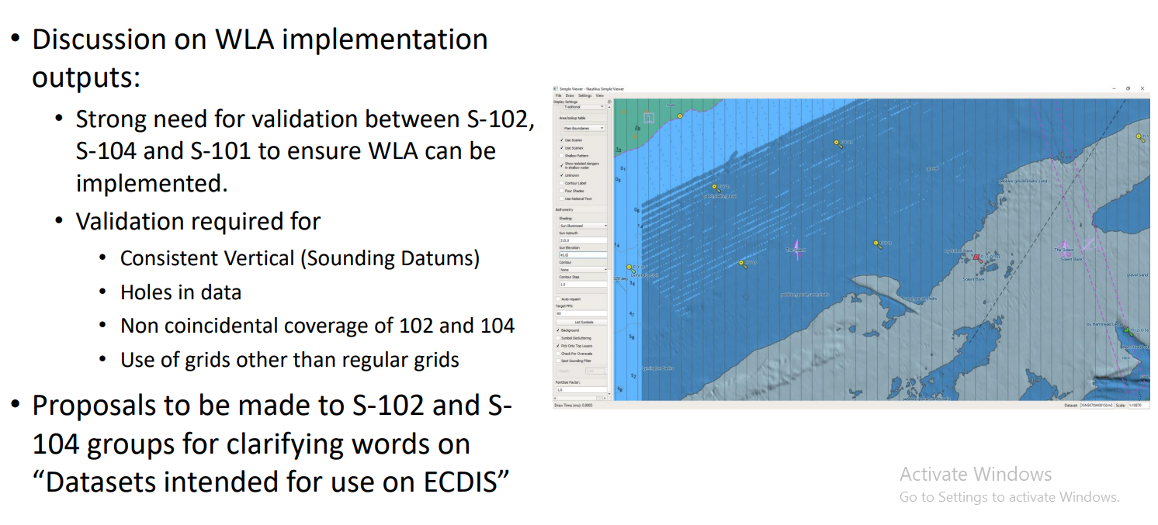
Inter-product validation
Remember – S-100 Validation tests are ECDIS specific at this stage

Slide 10
Next steps
Continue producing a set of tests from Parts of S-100
Review and integration of S-101 PT Proposed S-100 level tests
Categorisation of tests
Document write up with an initial explanation of ‘what is S-100 level validation’

Slide 11
Any Questions?

